Slide 1

FHA Information Modeling (IM) Project/FHIM Update
September 20, 2012

Slide 2

Near Term Goal of IM Project
Integrate the FHIM and its associated terminologies/value sets with Model-Driven Health Tools (MDHT) as the basis for a model driven architecture (MDA)approach to generating health IE implementation standards to support information sharing needs of the FHA federal partners

Slide 3
MDA Approach
Leverages a model driven architecture (MDA) approach to generate health information exchange (IE) implementation standards
Automates MDA steps to maximum extent possible
High-level MDA steps:
  Model information in FHIM and separately define terminologies and value sets to support the FHIM (FHIM is platform independent model (PIM))
    Significant subject matter expert participation
    Information is harmonized across FHA partners and across existing standards of SDOs
  Use implementation modeling tools (i.e. Model Driven Health Tools (MDHT) to generate a use case specific PIM
  Use MDHT to generate platform specific models (PSM) (e.g., NIEM, CDA, etc.) from use case specific PIM
  Use MDHT to constrain terminologies/value sets and bind them to the PSM
  Use MDHT to generate (one or more) platform specific health IE implementation standard, implementation documentation, test cases and reference implementations

Slide 4

FHIM Model Driven Architecture
Approach
FHIM Model
(PIM)
1
NIEM Health Domain
Harmonized
Uses
Lab Domain Integration Use Case
Constrains
2
Uses
Platform Independent
Lab Domain Exchange (PIM)
4
5
Platform Specific
MDHT
Transform
CDA Exchange PSM (UML)
NIEM Exchange PSM (UML)
8
Generate
Transform
Transform
Generate
9
6
7
CDA Implementation Guide Document
CDA Exchange Implementation
(Java)
NIEM Exchange PSM Implementation
(XSDs)
NIEM IEPD
Document

Slide 5
Discussion
Comments/Questions?

Slide 6
IM Project Summary
The IM Project/FHIM:
Produces freely available, harmonized information and terminology models and value sets
That are integrated with open source model-driven health tools
That can support multiple implementation platforms (PSMs), including NIEM
That can support the goals and requirements of the S&I Framework
And that can automate most of the process to produce information exchange implementation standards in an electronic format that is directly usable by organizations implementing the standards

Slide 7
Backup Slides

Slide 8
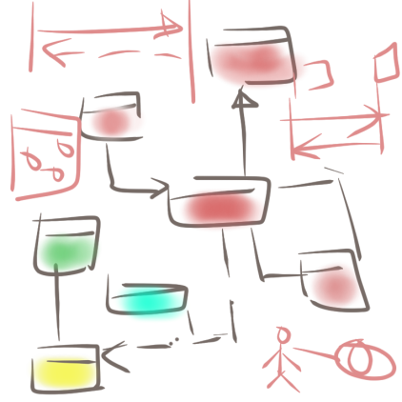
MDA Approach Steps
FHIM.emx
FHIM.emx
HITSP IS01
1
3
Use Case
Information
Requirements
Semantic Model Metadata
2
Harmonized
HITSP C35. C36, C37, C83
Coded Concept
Value Set Binding
HITSP C80/35
Terminology Model
Standard Coding System
Standard Coding System
Standard Coding System
Standard Coding System

Slide 9
MDA Approach Steps
CDA HITSP C37
FHIM.emx
Constraints
Clinical Document
Header
4
*
*
Section
*
*
5
Entry
Constraints
Choice
Act
NIEM
Extensions
Encounter
References
Extension
Observation
Media
Use Case
Organizer
Terminology Model
IEPD
Procedure
Region of
Interest
RSA 8.02 + MDHT Tools
Substance
Administration
constraints
<template>
LabResult
Supply

Slide 10
Current Status of Information and Terminology Modeling
FHIM Information Domains
 | Information Modeling Status | Terminology Modeling Status
AdverseEventReporting | Underway | To Be Modeled
Allergies | Complete | To Be Modeled
AudiologyAndSpeechPatho-logy | To Be Modeled | To Be Modeled
BehavioralHealth | Partially Complete | To Be Modeled
BloodBank | To Be Modeled | To Be Modeled
ClinicalDecisionSupport | To Be Modeled | To Be Modeled
ClinicalDocument | To Be Modeled | To Be Modeled
ClinicalObservations | To Be Modeled | To Be Modeled
Common | Complete | To Be Modeled
CompensationAndPension | To Be Modeled | To Be Modeled
Consultation | To Be Modeled | To Be Modeled
Datatypes | Complete | To Be Modeled
Dental | To Be Modeled | To Be Modeled
Dietetics | To Be Modeled | To Be Modeled
Encounter | Underway | To Be Modeled
EnrollEligibilityCOB | Complete | To Be Modeled
EventCapture | To Be Modeled | To Be Modeled
HealthFactors | To Be Modeled | To Be Modeled
HomeBasedPrimaryCare | To Be Modeled | To Be Modeled
Imaging | To Be Modeled | To Be Modeled
Immunizations | Underway | Underway
FHIM Information Domains
 | Information Modeling Status | Terminology Modeling Status
Lab | Underway | Underway
MentalHealth | To Be Modeled | To Be Modeled
OncologyRegistry | To Be Modeled | To Be Modeled
Orders | Complete | To Be Modeled
PatientEducation | To Be Modeled | To Be Modeled
Person | Complete | Complete
VaDodEligibility | To Be Modeled | To Be Modeled
Medications/Pharmacy | Underway | To Be Modeled
ProblemList | Complete | To Be Modeled
Prosthetics | To Be Modeled | To Be Modeled
Public Health Reporting | Underway | Underway
Radiology | To Be Modeled | To Be Modeled
SecurityAndPrivacy | Complete | To Be Modeled
SocialWork | To Be Modeled | To Be Modeled
SpinalCord | To Be Modeled | To Be Modeled
Surgery | To Be Modeled | To Be Modeled
VitalSigns | To Be Modeled | To Be Modeled
WomensHealth | To Be Modeled | To Be Modeled
Provider | Complete | To Be Modeled
CarePlan | To Be Modeled | To Be Modeled
PatientJournaling | To Be Modeled | To Be Modeled

